Slide 1
Project Summary
Jovan Hermawan and Zhang Han

Slide 2
Outline:
Device
Test original models
Convert Pytorch and Tensorflow models to TensorRT models
Deploy TensorRT model on the Device
What we learned

Slide 3
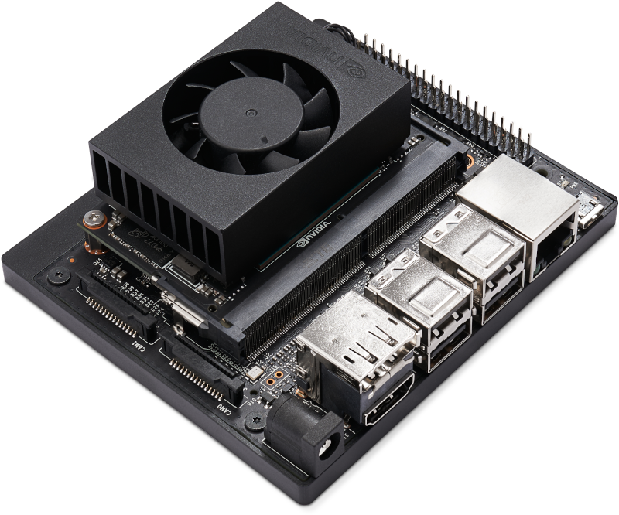
Device

Slide 4
2. Convert Pytorch models to TensorRT models

Slide 5
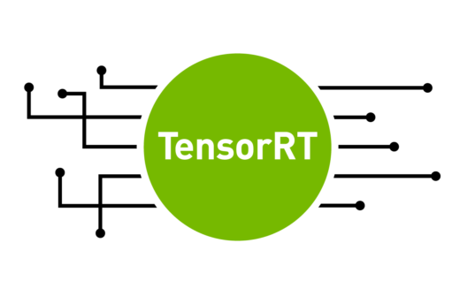
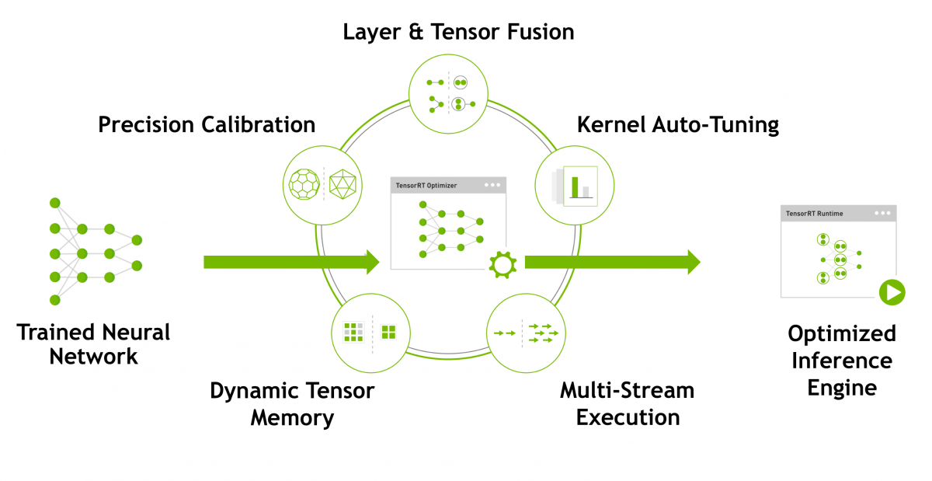

Slide 6



Slide 7
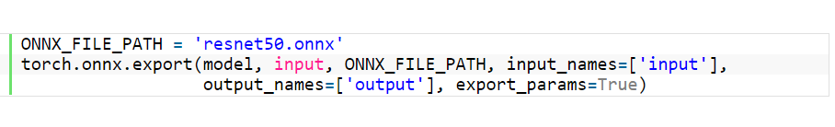

Slide 8

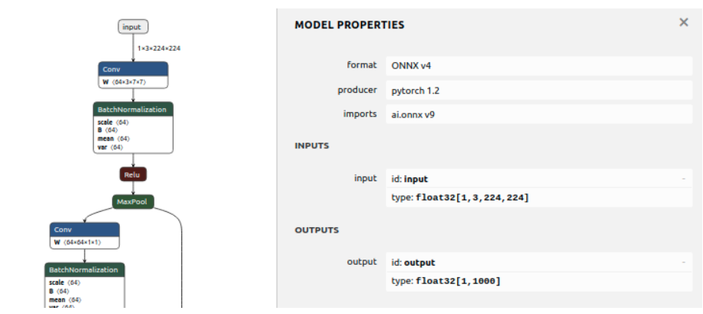

Slide 9
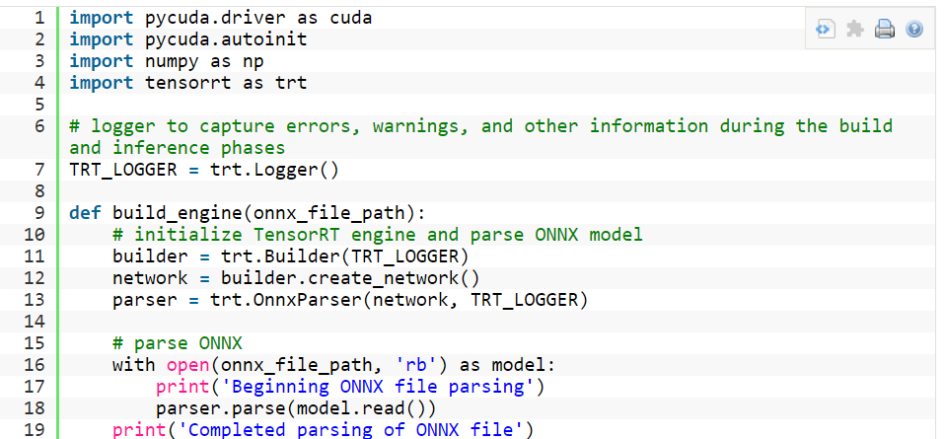

Slide 10
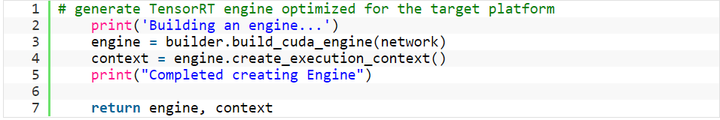

Slide 11
Alternative https://github.com/NVIDIA-AI-IOT/torch2trt
import torch
from torch2trt import torch2trt
from torchvision.models.alexnet import alexnet
# create some regular pytorch model...
model = alexnet(pretrained=True).eval().cuda()
# create example data
x = torch.ones((1, 3, 224, 224)).cuda()
# convert to TensorRT feeding sample data as input
model_trt = torch2trt(model, [x])

Slide 12
y = model(x)
y_trt = model_trt(x)

Slide 13
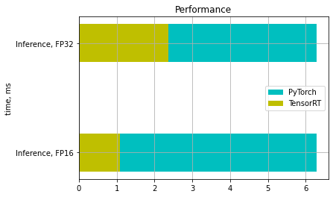

Slide 14
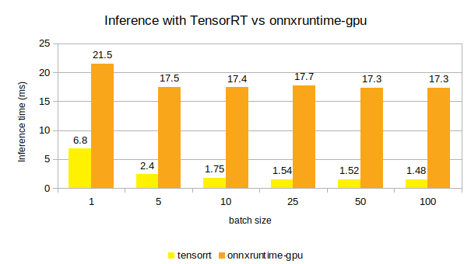

Slide 15
3. Test Tensorflow Models
Purpose:
To collect evaluate the performance of original Tensorflow models
prediction accuracy
time cost

Slide 16
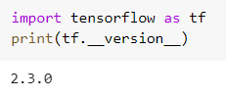

Prerequisits
libraries and packages

Slide 17
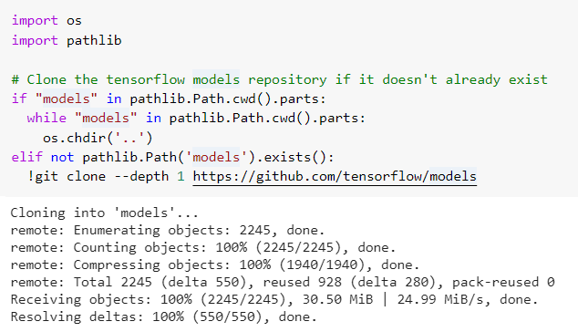
b. Clone/Download the model

Slide 18
c. Load the model and test data
to predict
d. Evaluate the performance

Slide 19
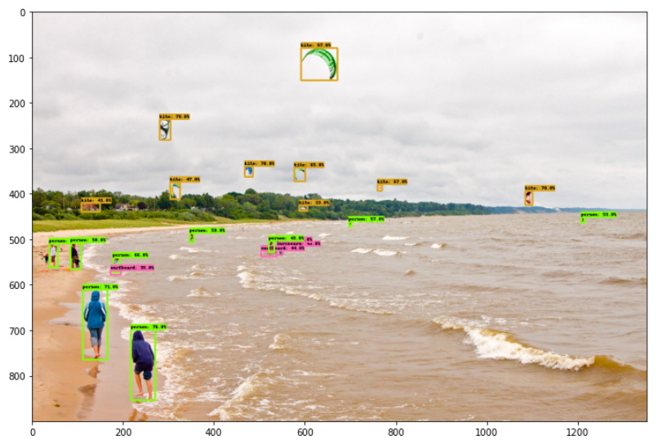
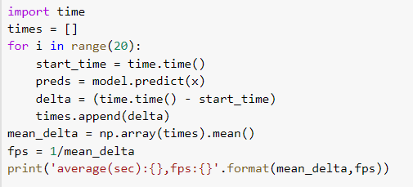
Prediction acurracy & Time cost
Time cost = end time - start time

Slide 20
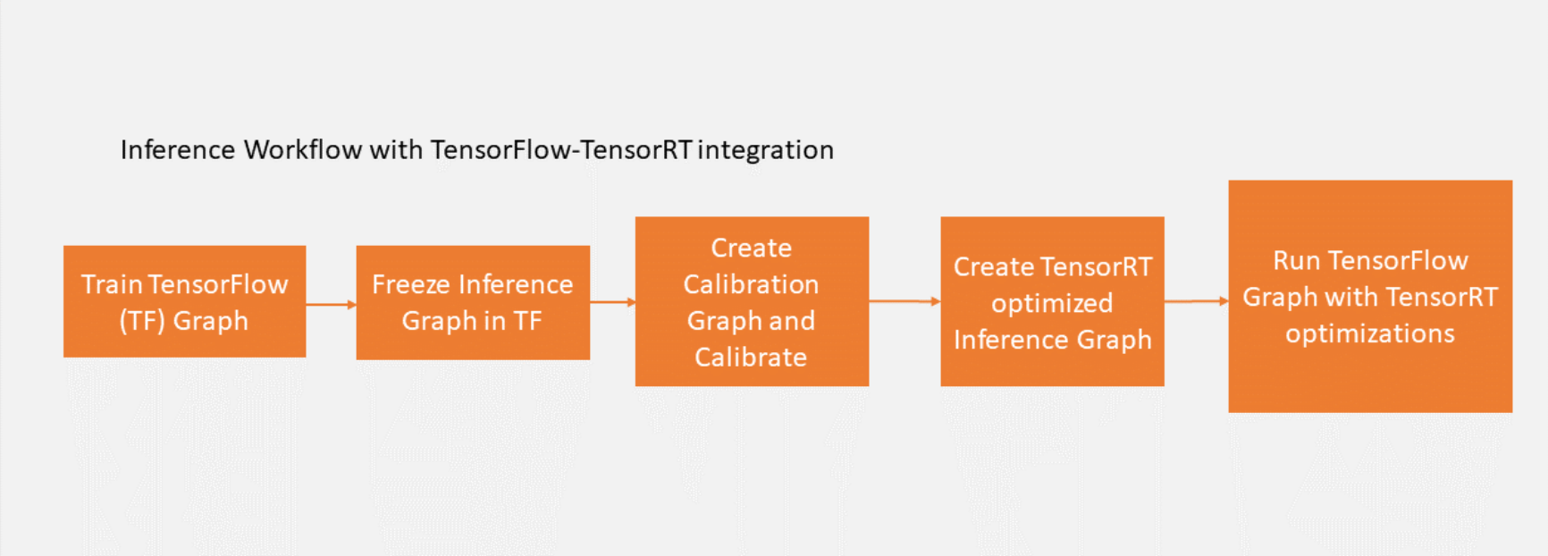
4. Convert Tensorflow Model to TensorRT model

Slide 21
gpu_options = tf.GPUOptions(per_process_gpu_memory_fraction = number_between_0_and_1)
trt_graph = trt.create_inference_graph(
input_graph_def=frozen_graph_def,
outputs=output_node_name,
max_batch_size=batch_size, max_workspace_size_bytes=workspace_size,
precision_mode=precision)

Slide 22
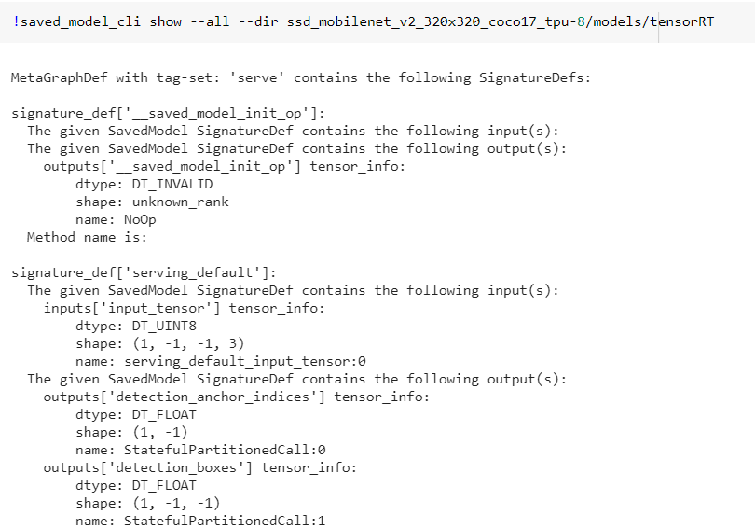

Slide 23
5. Deploy TensorRT model on the device
Transfer the TensorRT model
Build the running environment
Predict using pictures and videos
Further improvements

Slide 24
Transfer the TensorRT model
Build the running environment
See “Jetson Tutorial”

Slide 25
Predict using pictures and videos
Further improvements

Slide 26
Resources for the hole project

Slide 27
What we learned...

